Slide 1
DEEP LEARNING SEMESTER PROJECT
Waste Image Classification
Presented By: Shah Khan Aslam
Class: CS-7A
Roll No: SU92-BCSFM-F25-016
Course: Deep Learning

Slide 2
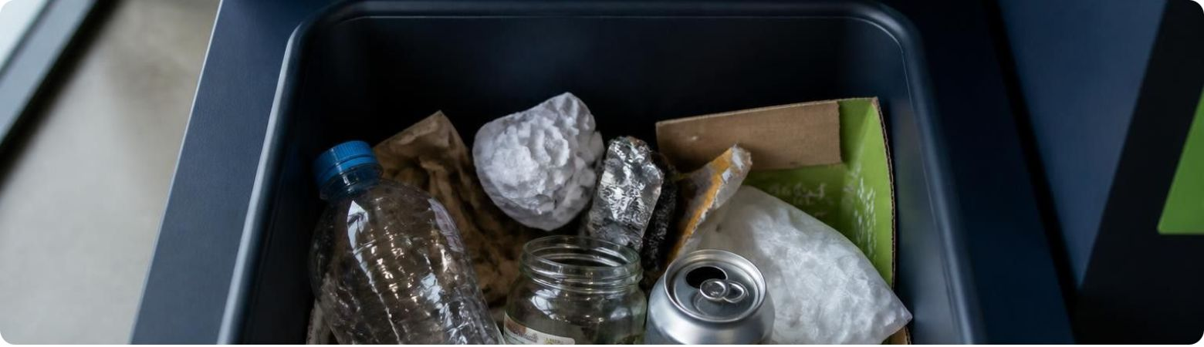
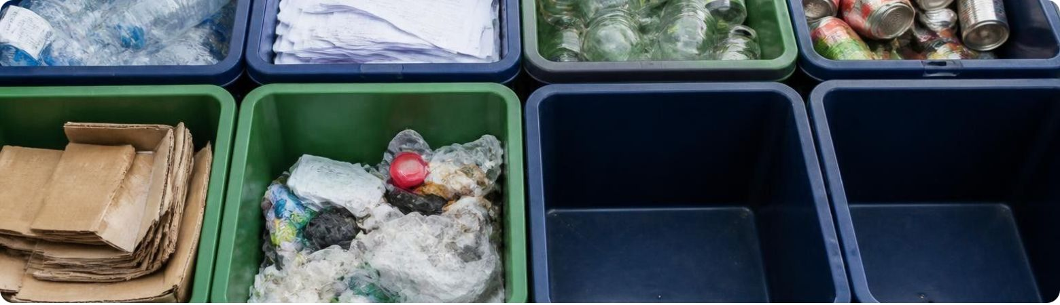
THE CHALLENGE & THE GOAL
Problem Statement & Project Objectives
The problem
Objectives
Improper waste segregation creates environmental pollution
Manual waste classification is time-consuming
Different materials require different recycling processes
Identify waste materials from images
Classify waste into different categories
Automate the waste classification process
Support better waste segregation and recycling
Deep Learning can automate waste identification through image recognition
Waste Image
→
AI Model
→
Predicted Category
2

Slide 3
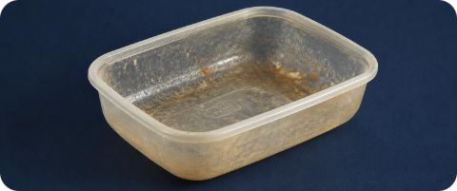
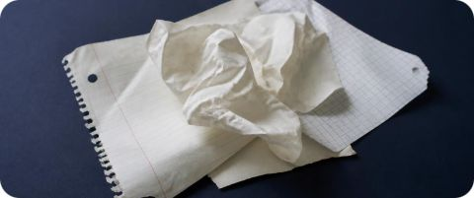
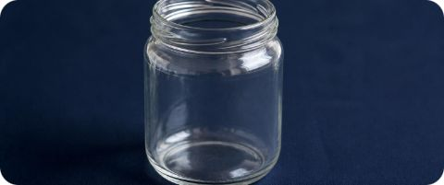
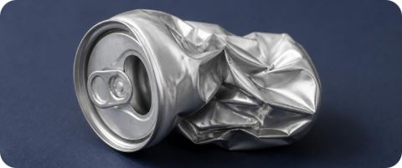
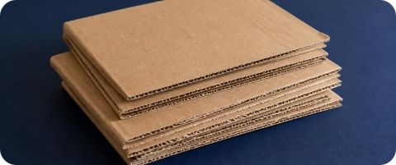
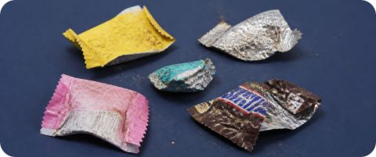

Dataset & Deep Learning Architecture
Labeled waste images used to train and evaluate an image classification model.
Plastic
Paper
Glass
Metal
Cardboard
Trash
Convolution extracts image features
ReLU introduces non-linearity
Max Pooling reduces feature dimensions
Dense layers perform classification
Softmax produces class probabilities
3

Slide 4
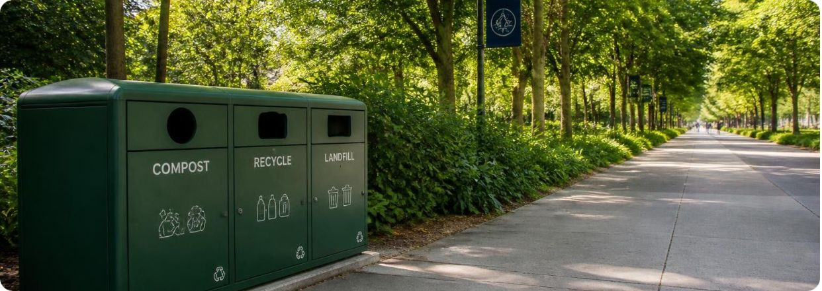
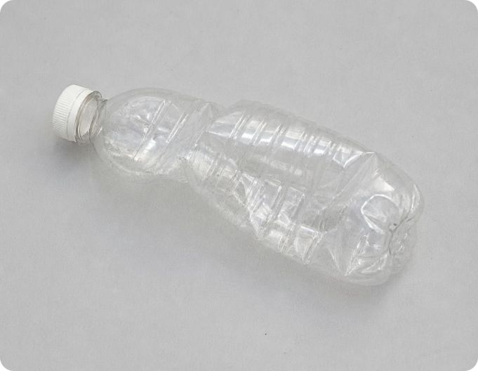
System Workflow & Application
1
2
3
4
5
Upload Waste Image
Image Preprocessing
Trained CNN Model
Classification
Predicted Category & Confidence Score
CONCEPTUAL WEB APP
Predicted category & confidence
Plastic
92%
Faster waste identification
Automated waste segregation
Support for recycling
Reduced manual effort
Illustrative example, not an actual experimental result
Using Deep Learning to Support Smarter Waste Management.
4

